Slide 1
One hidden layer
Neural Network
Activation functions

Slide 2


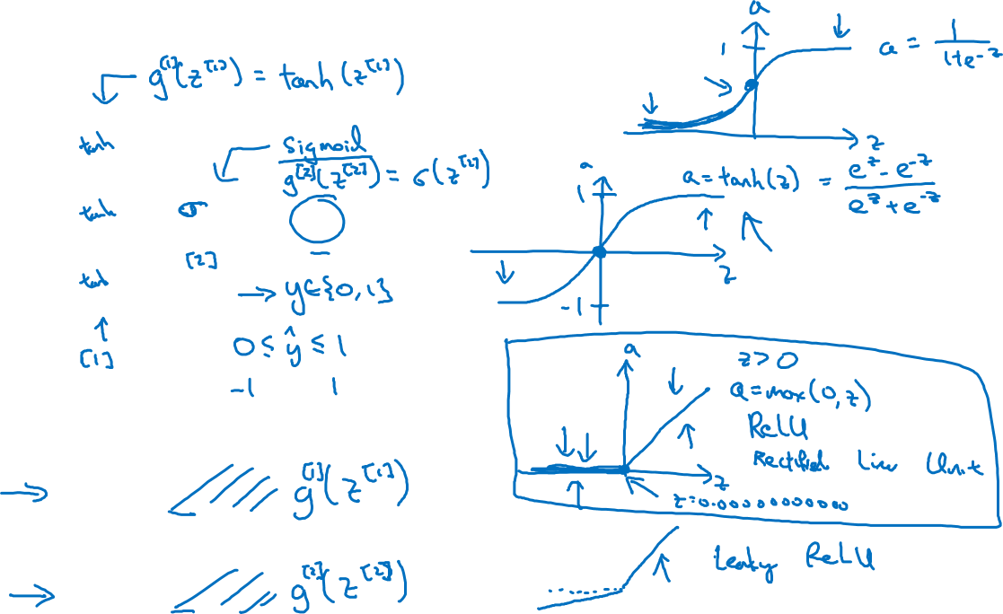




Activation functions
$$x_{1}$$
$$x_{2}$$
$$\hat{y}$$
$$x_{3}$$
Given x:
$$z^{\left[1\right]}=W^{\left[1\right]}x+b^{\left[1\right]}$$
$$a^{\left[1\right]}=σ(z^{\left[1\right]})$$
$$z^{\left[2\right]}=W^{\left[2\right]}a^{\left[1\right]}+b^{\left[2\right]}$$
$$a^{\left[2\right]}=σ(z^{\left[2\right]})$$
Notes:
tanh is superior to sigmoid in most case.
tanh outputs value between -1 and 1, its mean is 0, and that makes the learning of next layer faster.
The last layer should use sigmoid function, because we usually need y hat between 0 and 1.

Slide 3
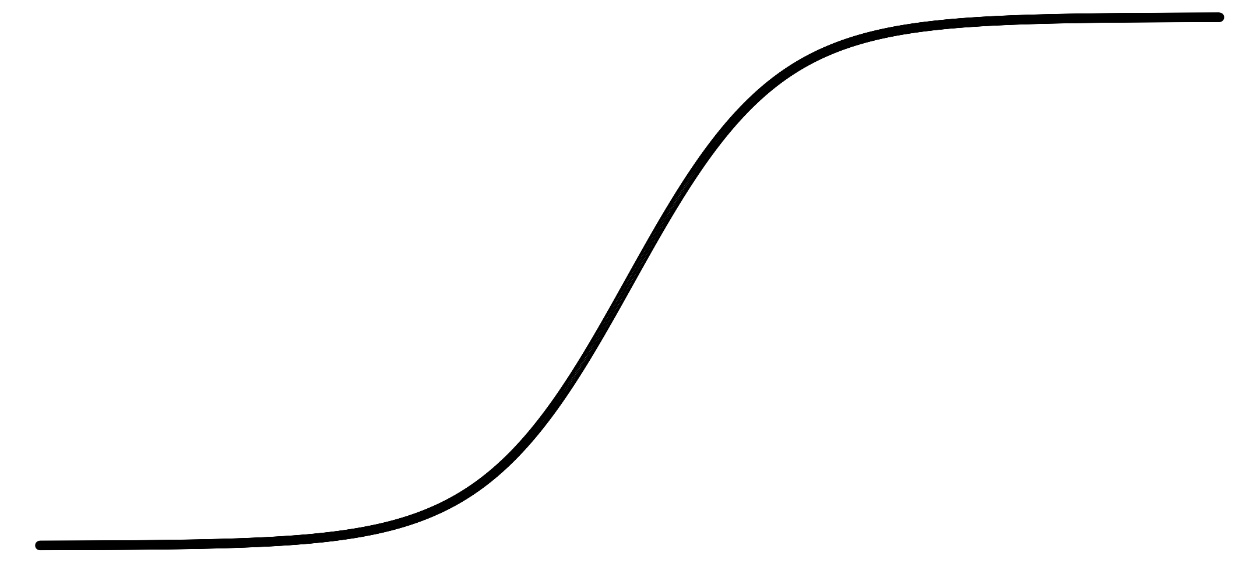
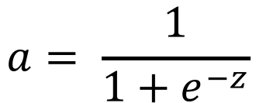
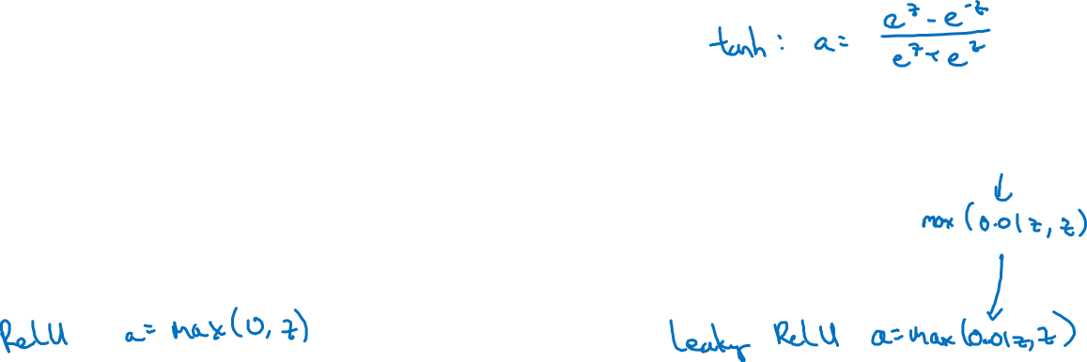
Pros and cons of activation functions
a
a
x
z
$$a= \frac{1}{1+e^{−z}}$$
sigmoid:
a
a
z
z

